Slide 1
Introduction to Linked Lists (continued)
By Mr. Radford Burger

Slide 2
Objectives
What is a linked list?
Basic operations on a Singly Linked List
Inserting a new node at the beginning of a singly linked list.
Inserting a new node at the Tail of a Singly Linked List
Removing an element in a Singly Linked List

Slide 3
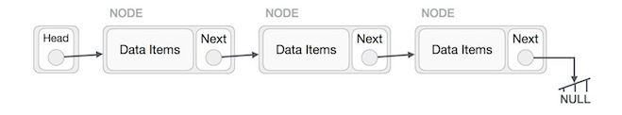
What is a Linked List?
a sequence of data structures or nodes , which are connected together via links
Nodes have two parts, value part and link part.
Value part is used to stores the data items
The link part (or next) is a reference, which is used to store addresses of the next element in the list.

Slide 4
Types of Linked Lists
Singly Linked List − Item navigation is forward only.
Doubly Linked List − Items can be navigated forward and backward.
Circular Linked List − Last item contains link of the first element as next and the first element has a link to the last element as previous

Slide 5
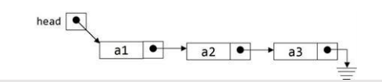


Types of Linked Lists
Singly Linked List
Doubly Linked List
Circular Linked List

Slide 6
Basic operations
Insertion − Adds an element to the list.
Deletion − Deletes an element from the list
Display − Displays the complete list
Search − Searches an element using the given key

Slide 7
Singly Linked List
Head: the only entry point to the list and all of its elements.
Head is a link
Tail: the last item in the list points to null

Slide 8

An empty Singly Linked List
empty list is represented by setting the head to null.

Slide 9
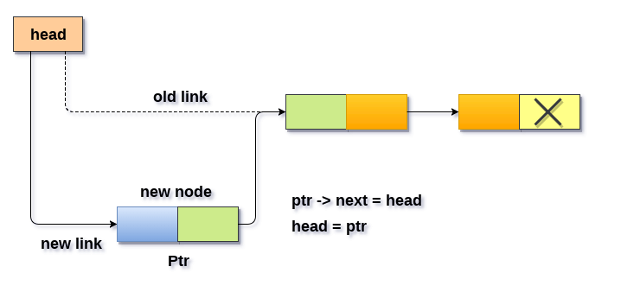
Insert at beginning of a Singly Linked List

Slide 10

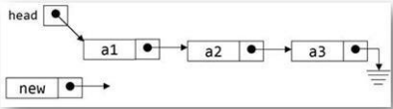
Insert at beginning of a Singly Linked List
Let’s break it down…

Slide 11
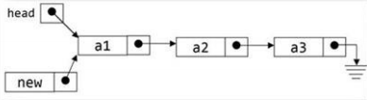
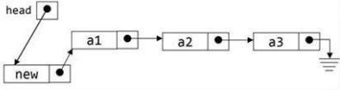
Insert at beginning of a Singly Linked List
Let’s break it down…

Slide 12
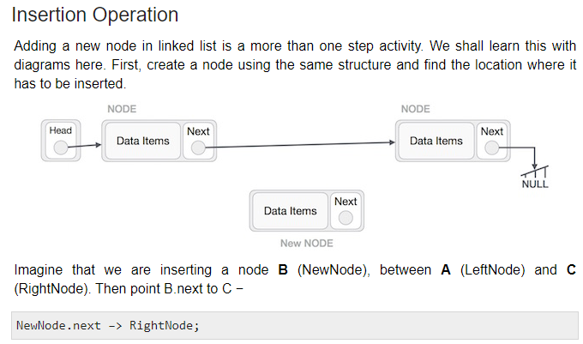
Insert at a specific position in a Singly Linked List

Slide 13
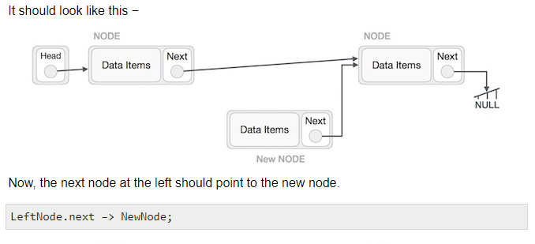
Insert at a specific position in a Singly Linked List

Slide 14
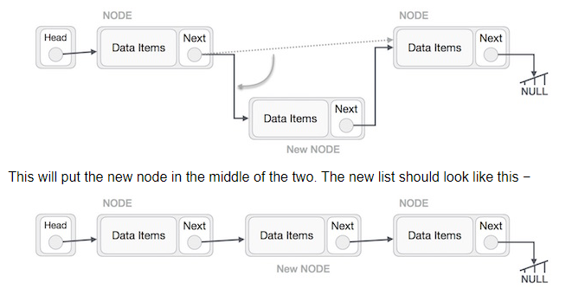
Insert at a specific position in a Singly Linked List

Slide 15
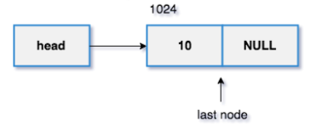
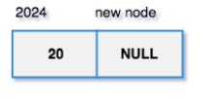
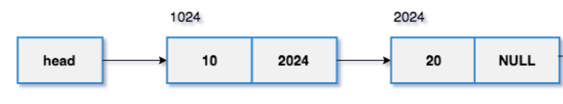
Insert at end of a Singly Linked List

Slide 16
Insert at end of a Singly Linked List
2. The new node with data as 20 and reference is NULL (address 2024).
1. The head points to the memory address 1024 and it is the last node.

Slide 17
Insert at end of a Singly Linked List
set last node.next = new node.
The new node added at the end of the linked list.

Slide 18
Something to think about…
How do you go about deleting the first element?
How do you go about deleting a node, given its value?
How do you go about deleting the last element?

Slide 19
Something else to think about…
Does the amount of time taken to insert an element at the beginning of an array depend on the length of the array?
Does the amount of time taken to insert an element at the beginning of a Linked List depend on the size of the list?

